Slide 1
Mapping
Advanced Android Development
Lesson 9

Slide 2
Contents
Introduction
API setup
Display map
Configure initial map state
Map types
Map styles and lite mode
Adding interactivity to maps
Moving the camera and view
Markers
Businesses and points of interest (POIs)
UI controls
Overlays and shapes
Street view

Slide 3

9.1 Adding a Google Map to your app
Using the Google Maps API

Slide 4
Introducing Maps API

Slide 5
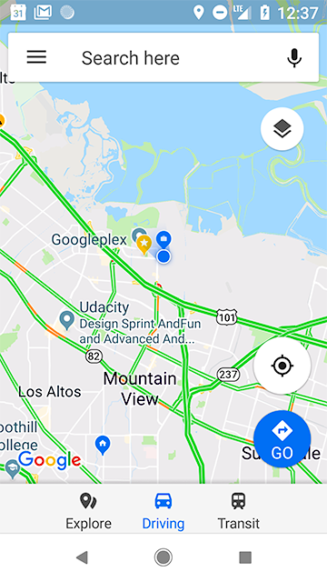
Google Maps
Google Maps API lets you include Google maps in your app
Notes:
Yep, that's right. You can add the Google Maps that we all know and love right into your own app.

Slide 6
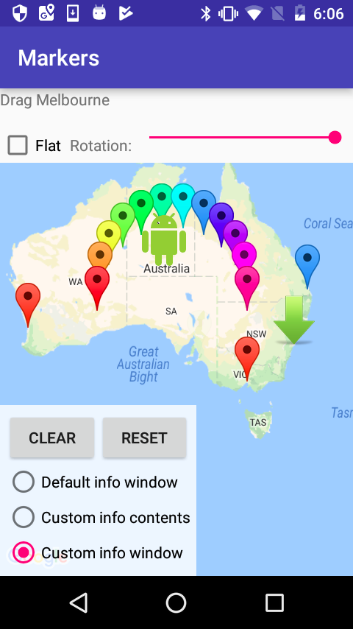
Customize maps in your app
Customize maps in your app:
Controls
Styles
Markers and more

Slide 7
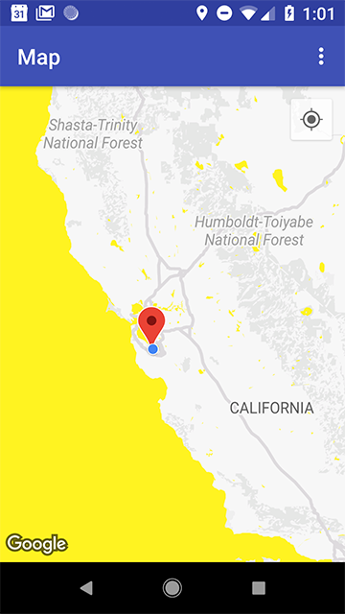
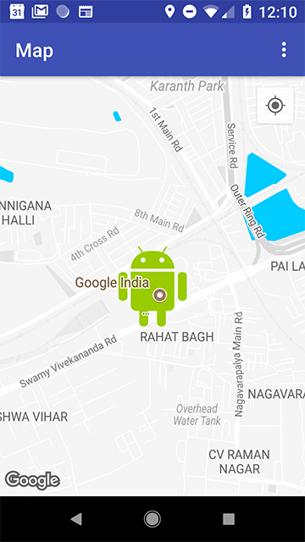
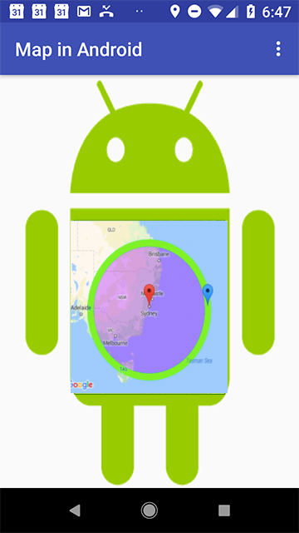
Customization examples
Change the color of the sea
Put Android on your map
Draw shapes on your map
Notes:
These are just examples of the customizations you can do, to give a flavor

Slide 8
API setup
Set up the project and get API keys

Slide 9
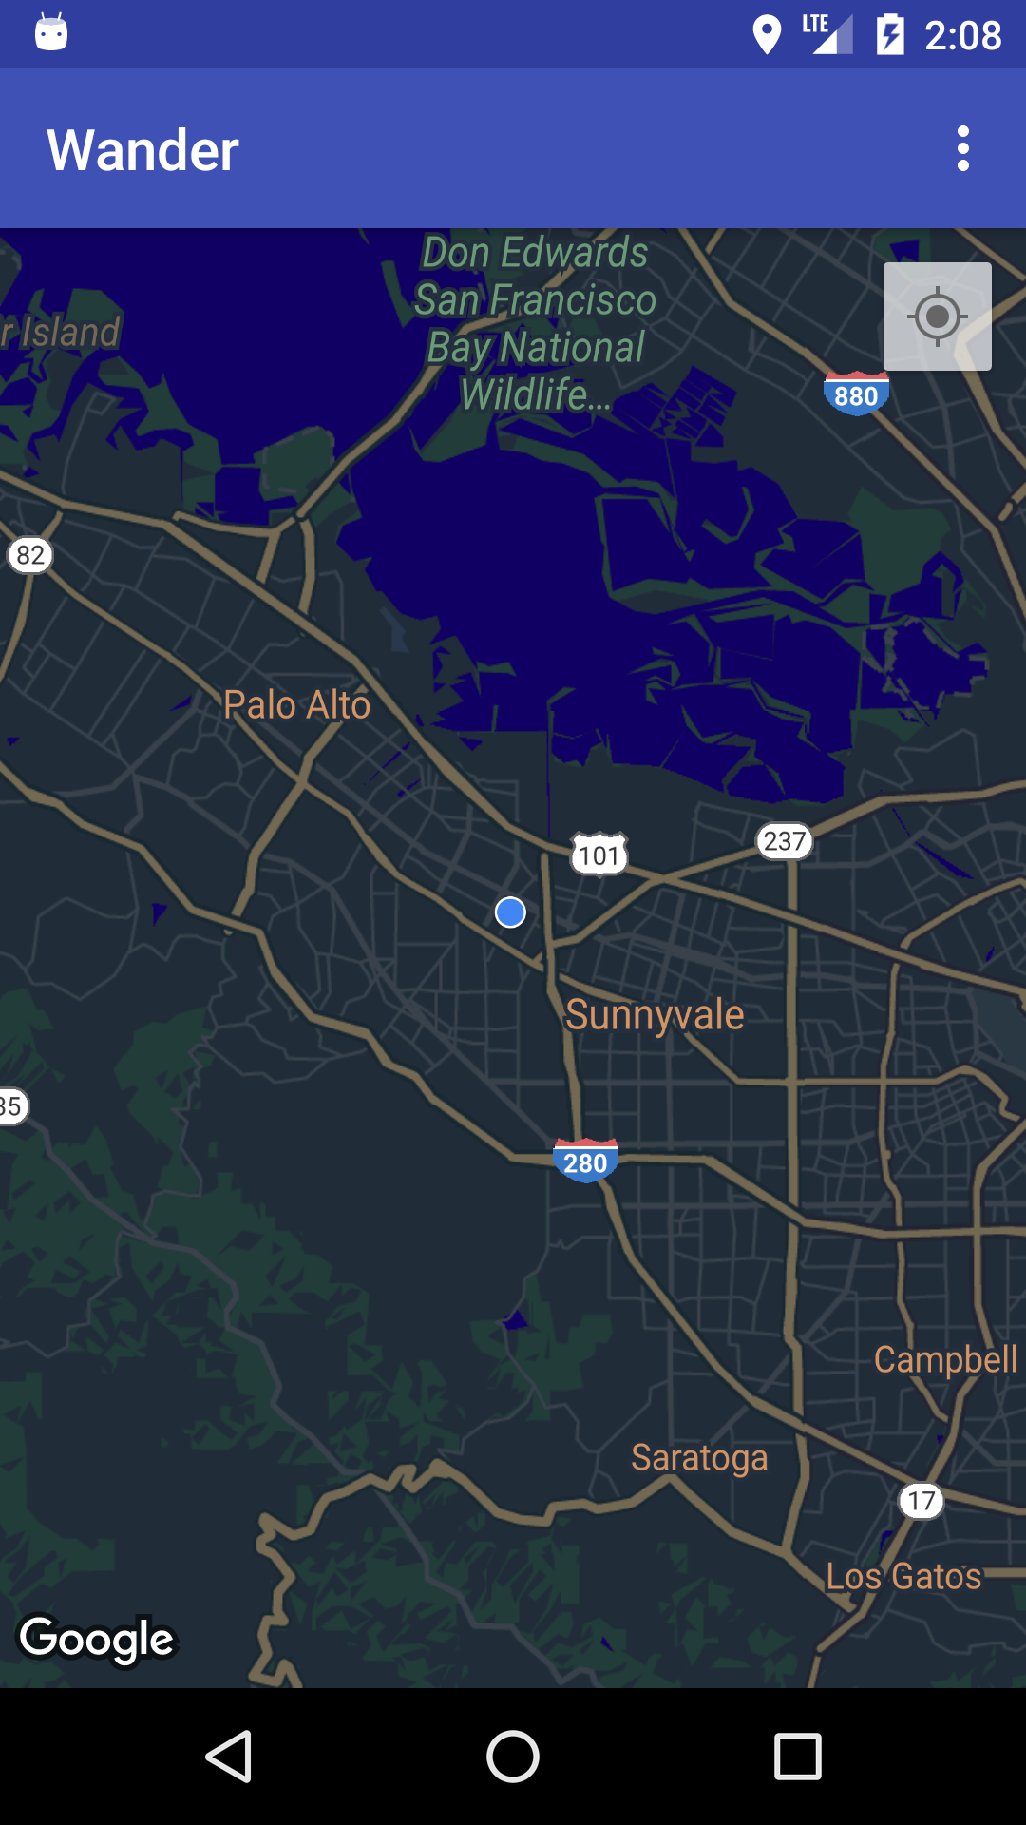
Adding a map to your app
Obtain API keys to use Google Map
Include a Google Map in your app
Change the look and feel of the map
Change map behavior

Slide 10
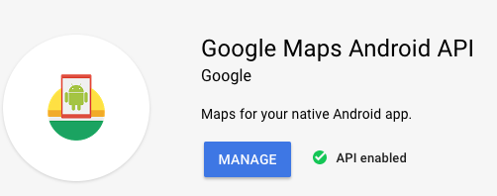
Register app and get API key
Register your app in Google API Console
Get debug certificate and release certificate and request API key
<meta-data android:name="com.google.android.geo.API_KEY" android:value="@string/google_maps_key" />

Slide 11
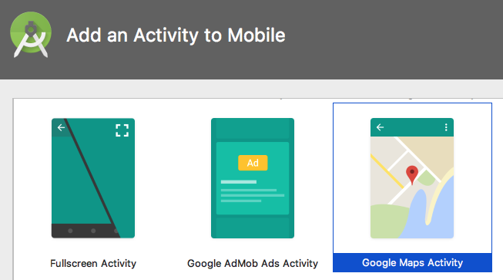
Use Google Maps Activity template
In Android Studio, use Google Maps Activity template
Creates boilerplate code
Gives link to get API key
Not using template? See API key guide

Slide 12
Get API debug key
Open google_maps_api.xml generated by template
Copy URL from comment and paste into browser
Follow instructions to enable Maps API and get API debug key
Paste API key into google_maps_api.xml
<string name="google_maps_key" templateMergeStrategy="preserve">
YOUR_KEY_HERE</string>

Slide 13
Displaying map in layout

Slide 14

Display map in layout
To add map to layout, use either:
MapView
MapFragment
With MapView, you must forward all lifecycle methods, so it's easier to use MapFragment

Slide 15
MapFragment
MapFragment places map in fragment container
Use SupportMapFragment for backward compatibility
Use <fragment> tag in layout
android:name=
"com.google.android.gms.maps.SupportMapFragment"

Slide 16
Map fragment example
<fragment
xmlns:android=
"http://schemas.android.com/apk/res/android"
android:id="@+id/map"
android:name=
"com.google.android.gms.maps.SupportMapFragment"
android:layout_width="match_parent"
android:layout_height="match_parent"/>

Slide 17
MapFragment attributes
You can specify additional map attributes
map:cameraTargetLat="-33.8"
map:cameraTargetLng="151"
map:cameraTilt="30"
map:cameraZoom="13"
map:mapType="normal"
and more!

Slide 18
onMapReadyCallback
Activity that shows maps must implement OnMapReadyCallback interface
When map is ready, map is passed to onMapReady()
getMapAsync() specifies where to call onMapReady() callback
GoogleMap represents the map

Slide 19
Create map example
@Override
protected void onCreate(Bundle savedInstanceState) {
...
// Get the SupportMapFragment
SupportMapFragment mapFragment = SupportMapFragment.newInstance();
getSupportFragmentManager(...);
mapFragment.getMapAsync(this);
}
Notice that the GoogleMap is not mentioned here. Get it in onMapReady() callback
Activity containing the onMapReady() callback
Notes:
Notice that the GoogleMap is not mentioned here. It is created and passed to the onMapReady() callback

Slide 20
onMapReady() callback
When map is ready, onMapReady() is called.
Initialize the GoogleMap in onMapReady()
Examples: initialize center of map, add markers, set zoom levels for initial map display

Slide 21
onMapReady() example
public void onMapReady(GoogleMap googleMap) {
// Add a marker in Sydney and move the camera
LatLng sydney = new LatLng(-34, 151);
googleMap.addMarker(new MarkerOptions().
position(sydney).
title("Marker in Sydney"));
googleMap.moveCamera(
CameraUpdateFactory.newLatLng(sydney));
}
Notes:
This is the default onMapReady when you use the Google Maps Activity templated

Slide 22
Configuring initial map state

Slide 23
What you can configure
Camera position, including location, zoom, bearing, and tilt
Map type
Whether zoom buttons appear and/or compass appears
Gestures to manipulate map
Enable lite mode (bitmap image with subset of functions)

Slide 24
Configuring initial map state
Configure initial map state
in code
or
as XML attributes for MapView or MapFragment

Slide 25
Custom XML attributes
Custom XML attributes for MapFragment or MapView
mapType, liteMode
cameraTargetLat, cameraTargetLng,
cameraZoom, cameraBearing, cameraTilt
uiZoomControls, uiZoomGestures,uiCompass
uiScrollGestures, uiRotateGestures, uiTiltGestures
zOrderOnTop

Slide 26
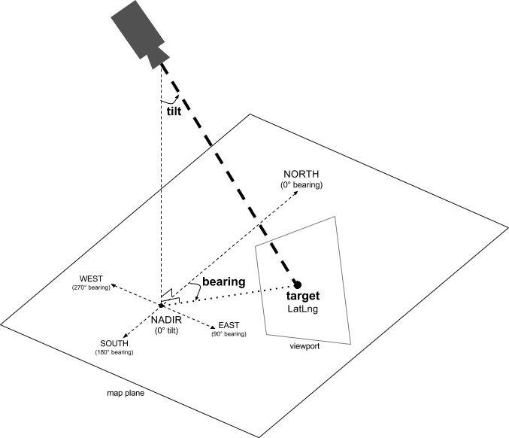

Slide 27
XML example (part 1)
<fragment
xmlns:android="http://schemas.android.com/apk/res/android"
xmlns:map="http://schemas.android.com/apk/res-auto"
android:name=
"com.google.android.gms.maps.SupportMapFragment"
android:id="@+id/map"
android:layout_width="match_parent"
android:layout_height="match_parent"
map:cameraBearing="112.5"
map:cameraTargetLat="-33.8"
...

Slide 28
XML example (part 2)
map:cameraTargetLng="151"
map:cameraTilt="30"
map:cameraZoom="13"
map:mapType="normal"
map:uiCompass="false"
map:uiRotateGestures="true"
map:uiTiltGestures="true"
map:uiZoomGestures="true"/>

Slide 29
Define map options in code
Define map options in either
constructor for MapView or MapFragment
onMapReady() callback
Use GoogleMapOptions to specify map options

Slide 30
GoogleMapOptions
Create GoogleMapOptions object
GoogleMapOptions options = new GoogleMapOptions();
Configure initial state
options.mapType(GoogleMap.MAP_TYPE_SATELLITE)
.compassEnabled(false)
.rotateGesturesEnabled(false)
.tiltGesturesEnabled(false);

Slide 31
Setting the map type

Slide 32
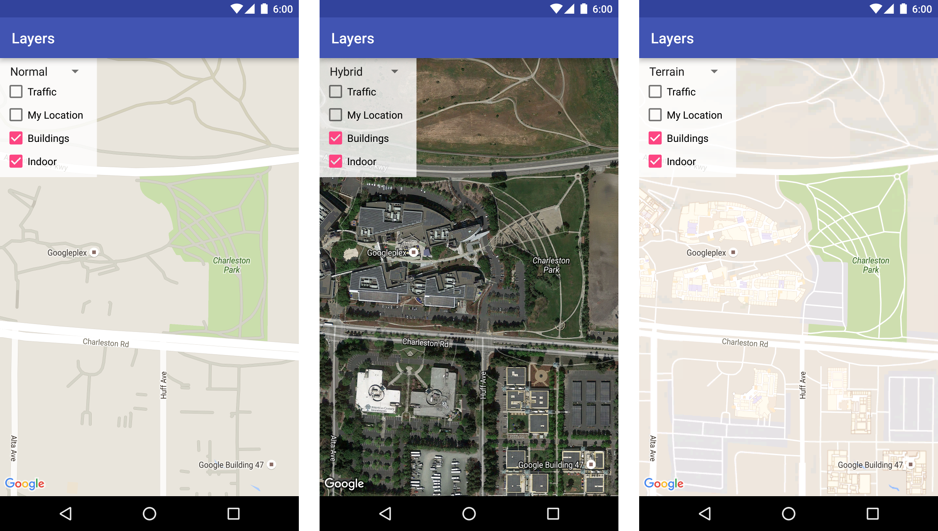
Map types
Normal: Road map
Satellite: Satellite photo
Hybrid: Satellite and roads
Terrain: Topographic data
None: No tiles
Normal
Hybrid
Terrain

Slide 33
Set map type
Call setMapType() with GoogleMap type constant
Example of setting to "hybrid" type:
GoogleMap map;
// Sets the map type to "hybrid"
mMap.setMapType(GoogleMap.MAP_TYPE_HYBRID);

Slide 34
Setting map styles and lite mode

Slide 35
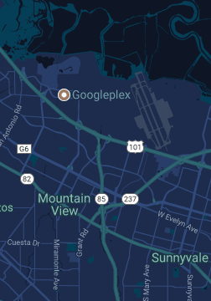
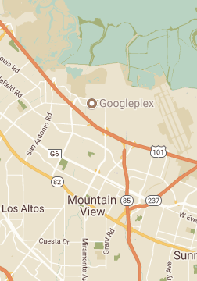
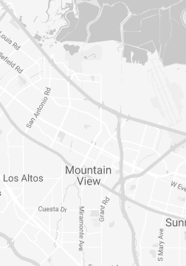
Map styles
You can change the style of your maps

Slide 36
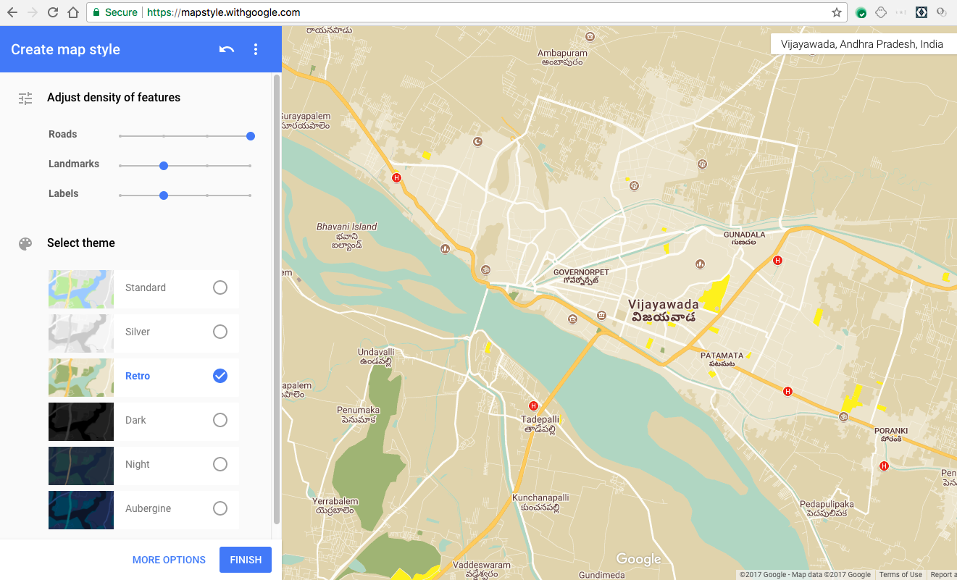
Use style wizard to get styles
mapstyle.withgoogle.com

Slide 37
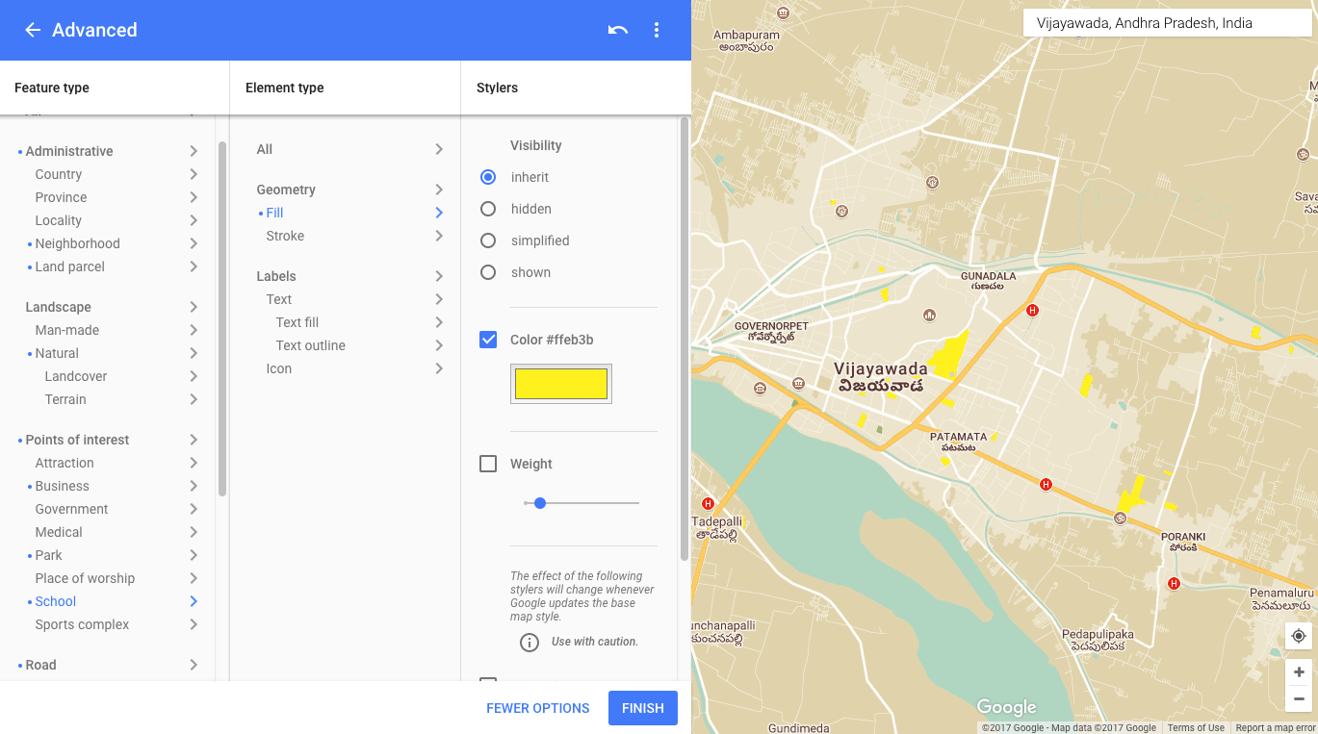
Use style wizard to get styles
More options

Slide 38
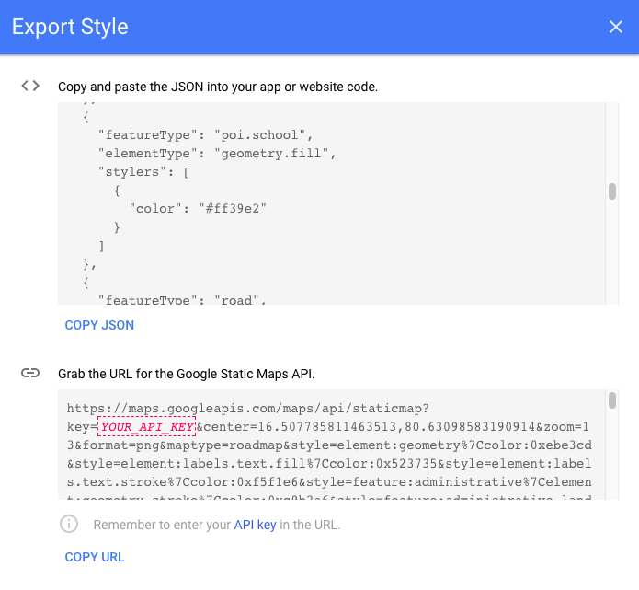
Get style as JSON
Style wizard generates JSON file

Slide 39
Styling a map
Change display of features
Normal map type only
No effect on indoor map
Style changes
Select geographic components (roads, parks, etc.)
Set styles for color and visibility properties
See style reference for JSON styling options

Slide 40
Steps to styling a map
Use style wizard to generate style
Save JSON file in raw resource directory
Call GoogleMap.setMapStyle() passing in a MapStyleOptions object that loads resource

Slide 41
GoogleMap.setMapStyle()
googleMap.setMapStyle(
MapStyleOptions.loadRawResourceStyle(
this, R.raw.map_style));

Slide 42
Catch errors and exceptions
try {
// Customize styling of map using a JSON object defined
// in a raw resource file.
boolean success = googleMap.setMapStyle(
MapStyleOptions.loadRawResourceStyle(this, R.raw.map_style));
if (!success) {
Log.e(TAG, "Style parsing failed.");
}
} catch (Resources.NotFoundException e) {
Log.e(TAG, "Can't find style file. Error: ", e);
}

Slide 43
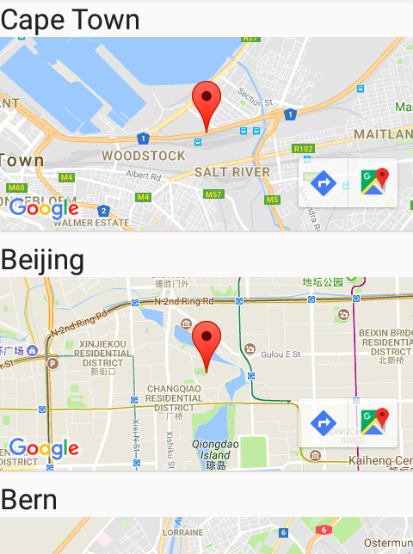
Lite mode
Bitmap image of a map, offers limited interactivity to the user.
Supports all map types
Supports only a subset of full API
Useful for list of maps or small map without interaction

Slide 44
Implementing lite mode
Set Google Map to lite mode in XML:
map:liteMode="true"
Or set in GoogleMapOptions object:
GoogleMapOptions options = new GoogleMapOptions().liteMode(true);

Slide 45
Adding interactivity to maps

Slide 46
Listening to map events
Map click or map touch and hold
Camera change
Business or point of interest (POI)
Indoor map
Marker and info window
Shape and overlay
For details see Events

Slide 47
GoogleMap events
GoogleMap object has many listeners
OnMapClickListener
OnMapLongClickListener
OnMarkerClickListener
OnMyLocationChangeListener… // and more

Slide 48
Moving the camera and view

Slide 49
Camera and view
Change user's view by modifying map's camera
Detect where user clicks
OnMapClickListener.onMapClick() receives latitude and longitude
Your app can zoom camera to that point
Other examples
Responding to tap on marker bubble
Responding to drag gesture on marker

Slide 50
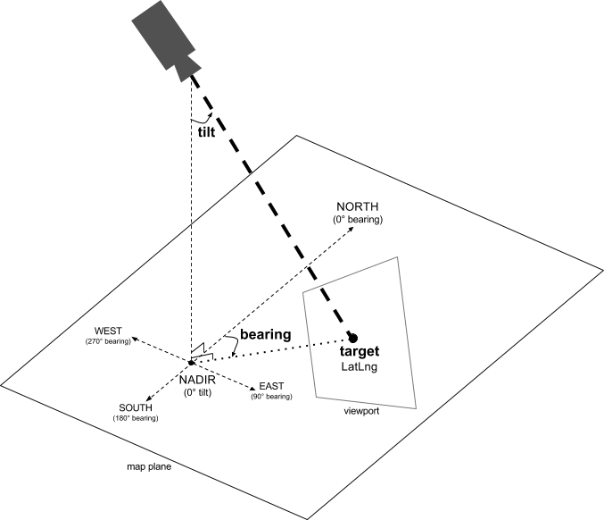
Camera position
Camera position specified by:
Target location
Bearing
Tilt
Zoom

Slide 51
Camera position aspects
Target (location): center of map latitude/longitude location
Bearing (orientation): vertical line direction measured in degrees clockwise from north
Tilt (viewing angle): perspective
Zoom: Scale of map

Slide 52
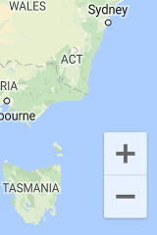
Zoom levels
1 | World
5 | Landmass/continent
10 | City
15 | Streets
20 | Buildings

Slide 53
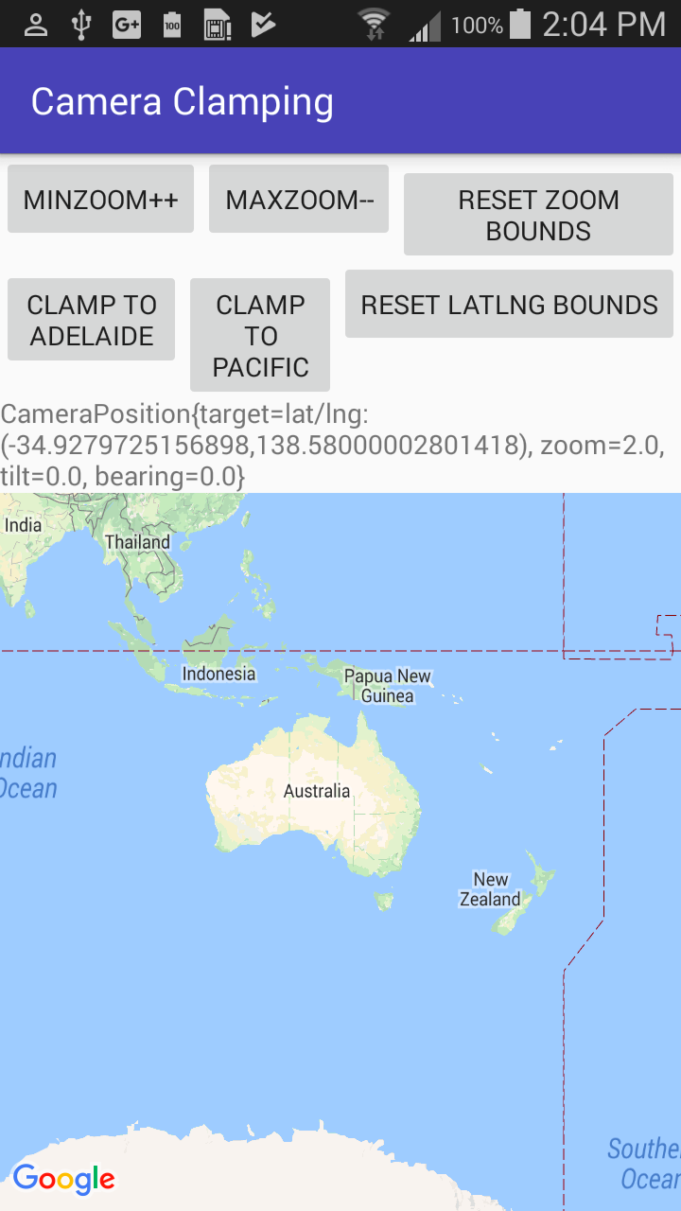
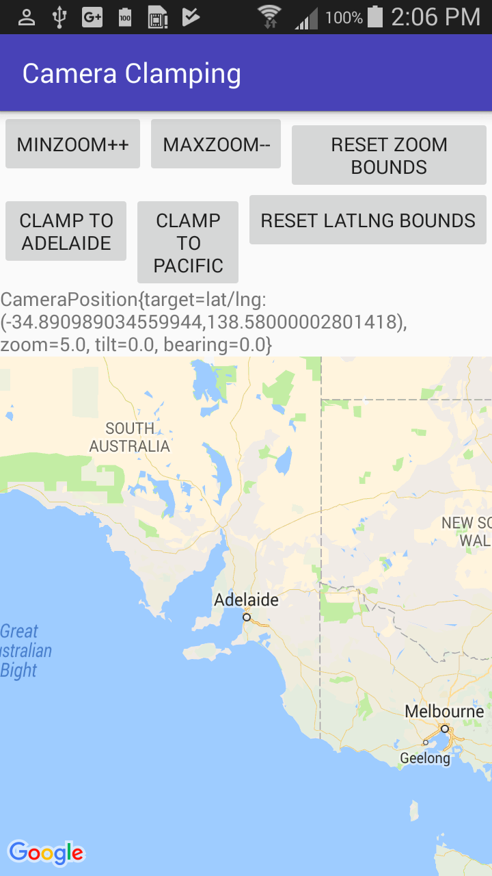
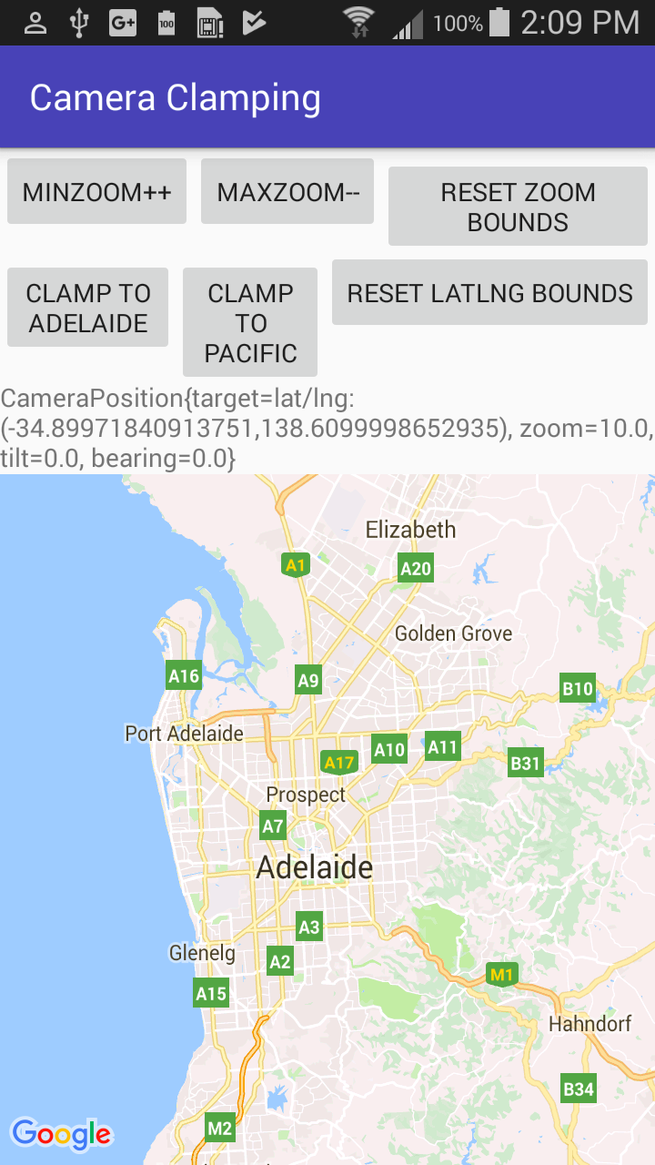
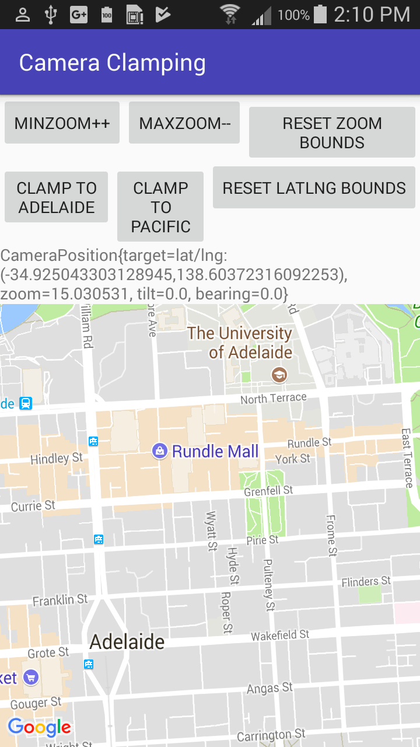
Zoom levels
Zoom level 2.0
Zoom level 5.0
Zoom level 10.0
Zoom level 15.0

Slide 54
Steps for moving the camera
Specify zoom level
Pan and zoom with CameraUpdateFactory.newLatLngZoom()
mMap.moveCamera(CameraUpdateFactory.newLatLngZoom(home, zoom));

Slide 55
Markers

Slide 56
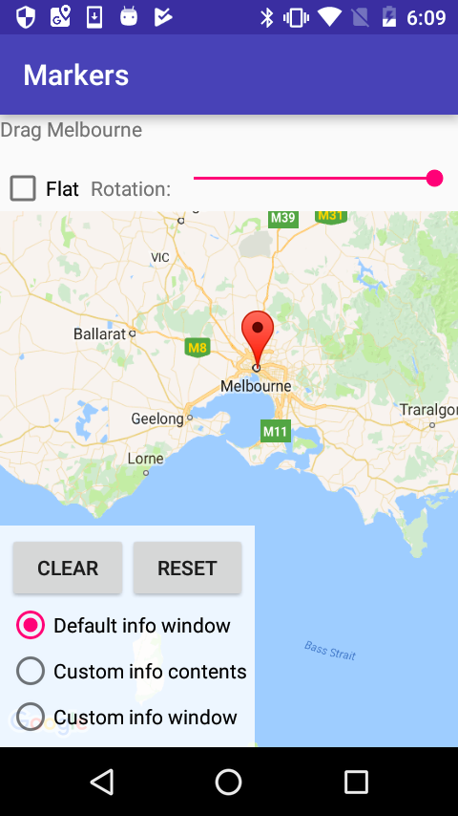
Using map markers
Default marker
Customized markers

Slide 57
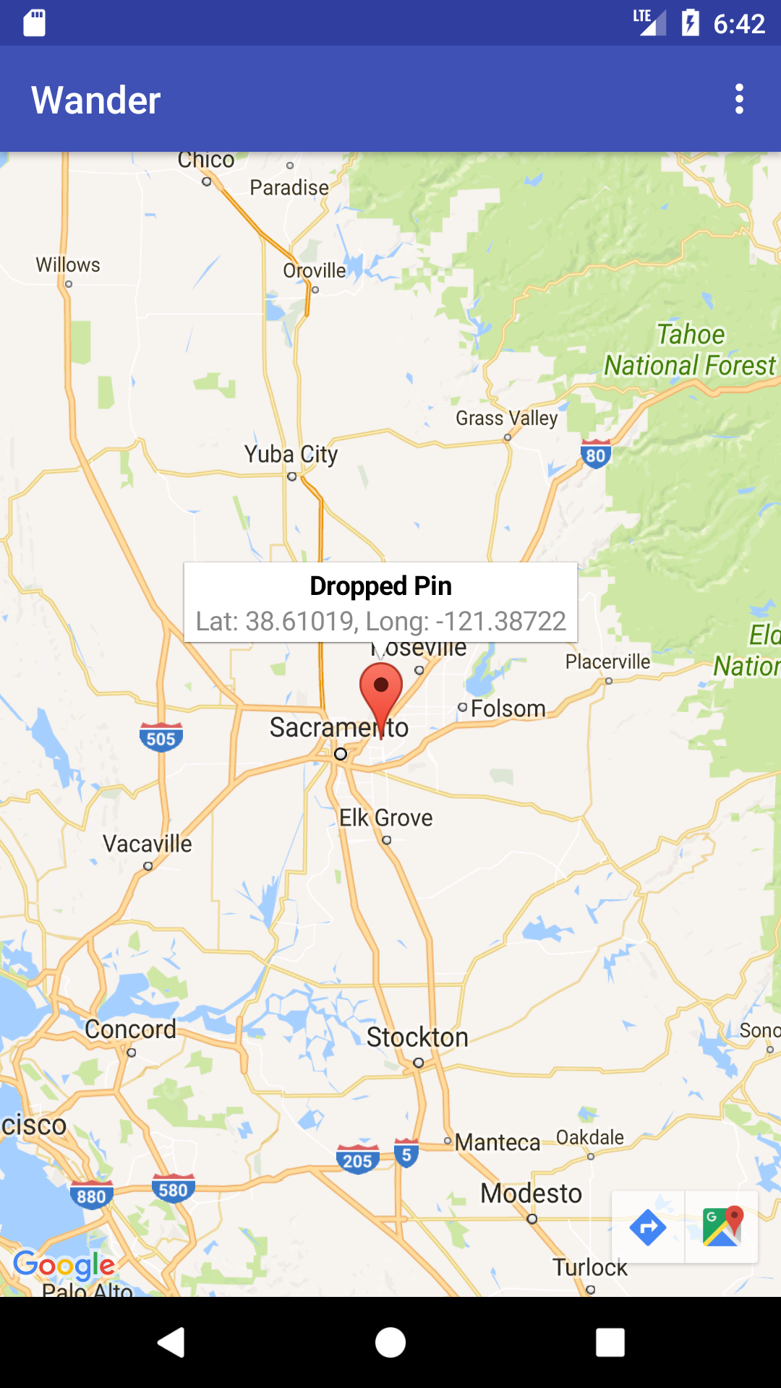
Adding map markers
Add Marker objects
GoogleMap.addMarker(markerOptions)
Change marker color, image, or anchor point in markerOptions
See Markers for details

Slide 58
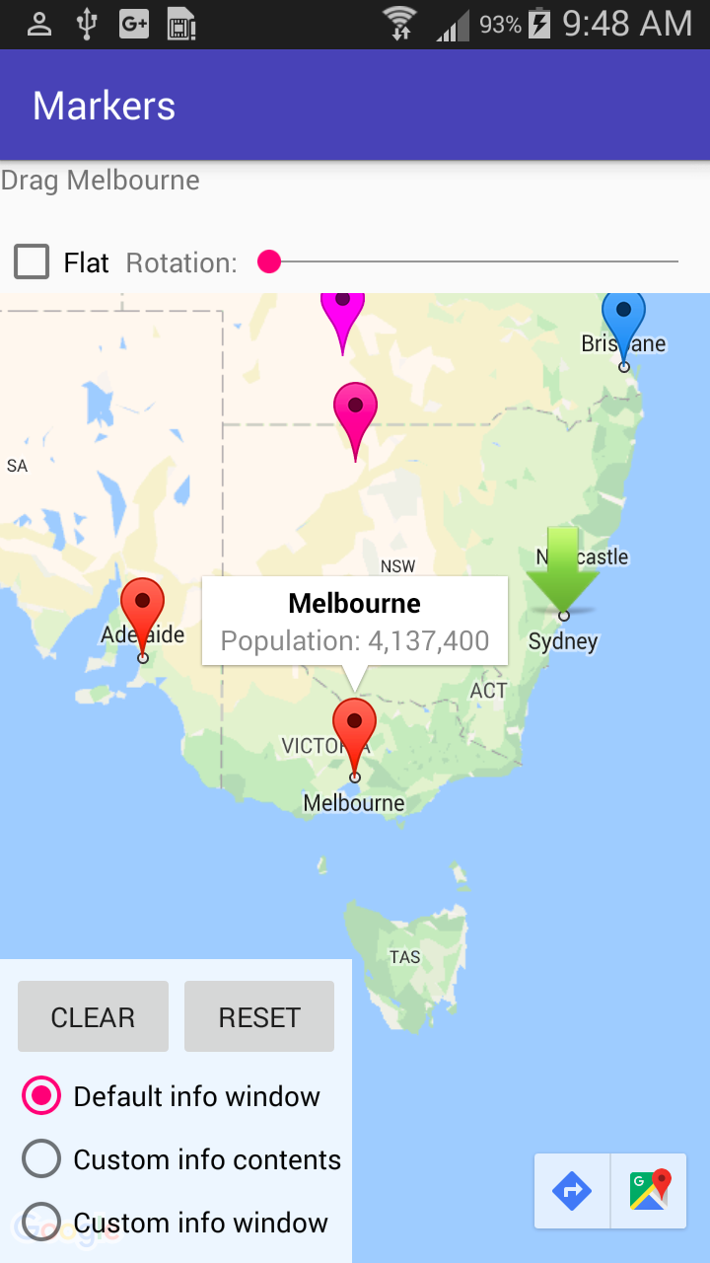
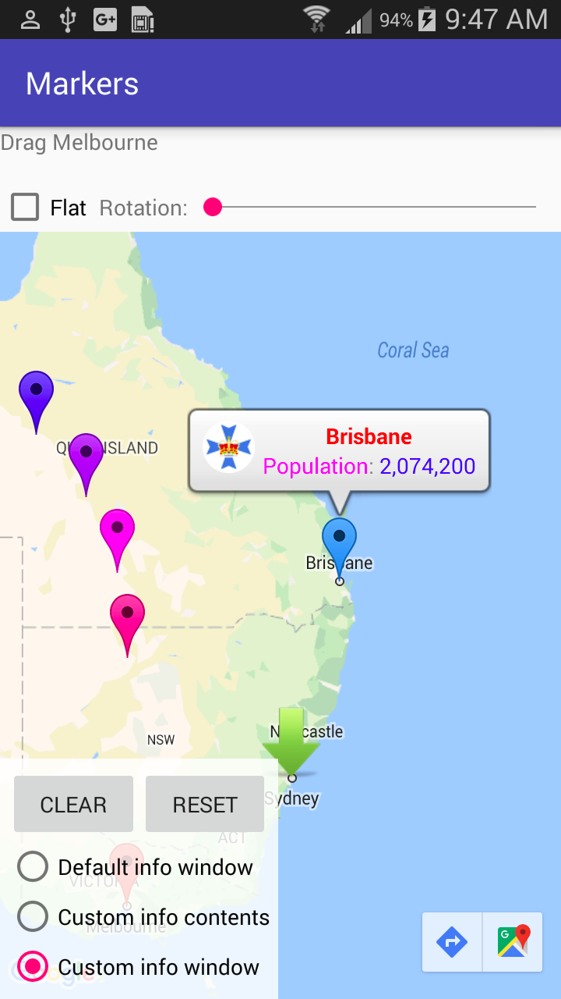
Info windows
Default info window
Customized info window

Slide 59
Customize the info window
Set title and snippet for info window when creating marker
Set click response with GoogleMap.setInfoWindowClickListener() – gets LatLng of clicked location

Slide 60
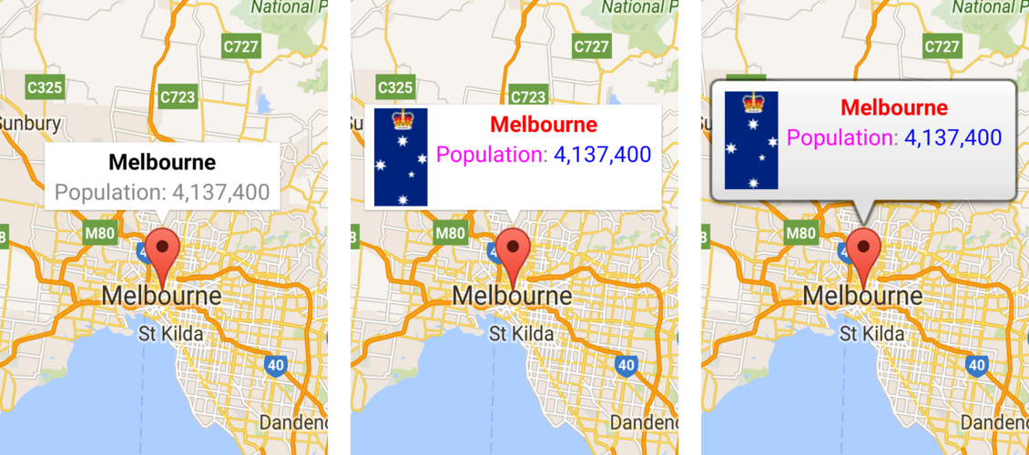
Customize the info window
You can create custom info windows, see Info Windows reference

Slide 61
Businesses and points of interest

Slide 62
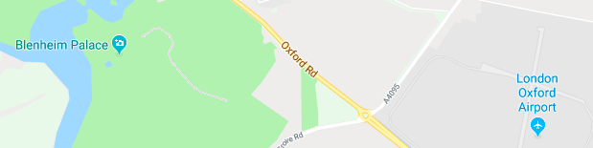
Points of interest
Points of interest
Attraction
Business
Government
Medical
Park
Place of worship
School
Sports complex

Slide 63
Businesses and points of interest (POIs)
POI corresponds to place defined in Google Places API
Base map: POIs appear by default
Normal map type: Businesses and POIs by default
Respond to POI click and display info window with OnPoiClickListener

Slide 64
Steps to use OnPoiClickListener
Set OnPoiClickListener in onMapReady()
GoogleMap.setOnPoiClickListener(OnPoiClickListener)
When user taps POI, app receives onPoiClick(PointOfInterest) event
Get latitude/longitude coordinates, place ID, and name of POI from PointOfInterest received from event

Slide 65
GoogleMap.OnPoiClickListener
public class OnPoiClickDemoActivity extends
FragmentActivity implements OnMapReadyCallback,
GoogleMap.OnPoiClickListener {
@Override
protected void onCreate(Bundle savedInstanceState) {
super.onCreate(savedInstanceState);
setContentView(R.layout.poi_click_demo);
SupportMapFragment mapFragment = (SupportMapFragment)
getSupportFragmentManager()
.findFragmentById(R.id.map);
mapFragment.getMapAsync(this);
}
Notes:
This is just creating the map

Slide 66
onPoiClick() example
@Override
public void onMapReady(GoogleMap map) {
map.setOnPoiClickListener(this);
}
@Override
public void onPoiClick(PointOfInterest poi) {
Toast.makeText(getApplicationContext(), "Clicked: " +
poi.name + "\nPlace ID:" + poi.placeId + "\nLatitude:" +
poi.latLng.latitude + " Longitude:" + poi.latLng.longitude,
Toast.LENGTH_SHORT).show();
}

Slide 67
UI controls

Slide 68
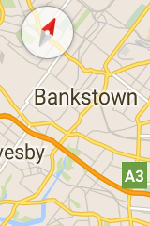
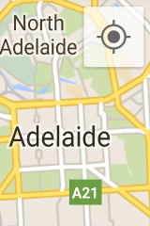
UI controls
Zoom controls
Compass
Location button

Slide 69
UI controls
Use UiSettings to change visibility of UI controls GoogleMap.getUiSettings()
Enable/disable zoom control: UiSettings.setZoomControlsEnabled(boolean)
Enable/disable compass: UiSettings.setCompassEnabled(boolean)
Enable/disable toolbar: UiSettings.setMapToolbarEnabled(boolean)

Slide 70
Gestures
Enable/disable zoom gestures with UiSettings.setZoomGesturesEnabled(boolean)
Enable/disable scrolling/panning with UiSettings.setScrollGesturesEnabled(boolean)
Enable/disable tilt gestures with UiSettings.setTiltGesturesEnabled(boolean)
Enable/disable rotation with UiSettings.setRotateGesturesEnabled(boolean)

Slide 71
Overlays and shapes

Slide 72
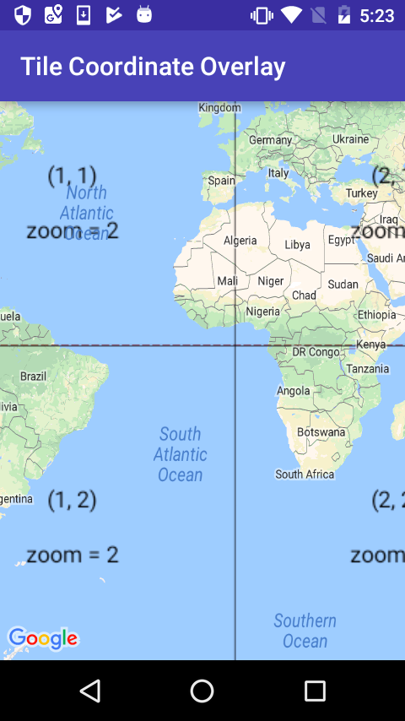
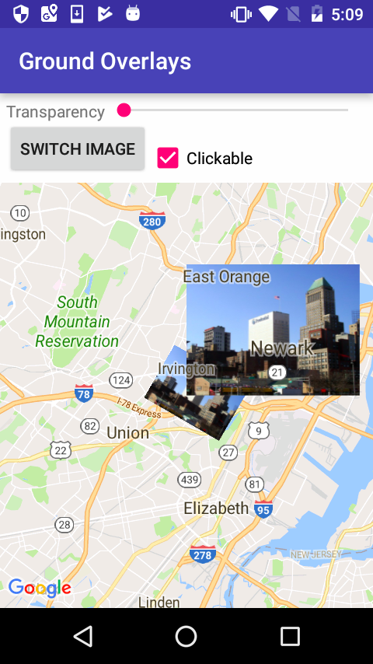
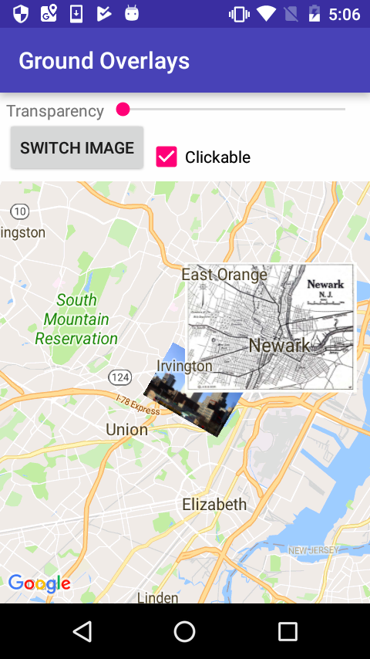
Use ground and tile overlays
Ground overlay: Image fixed on map at specific point
Tile overlay: Set of images added on top of base map tiles
Ground overlays
Tile overlays

Slide 73
Adding a ground overlay
Create GroundOverlayOptions and use BitmapDescriptorFactory.fromResource()
Set the position property:
GroundOverlayOptions homeOverlay = new
GroundOverlayOptions()
.image(BitmapDescriptorFactory
.fromResource(R.drawable.android))
.position(home, 100);
Call addGroundOverlay():
mMap.addGroundOverlay(homeOverlay);

Slide 74
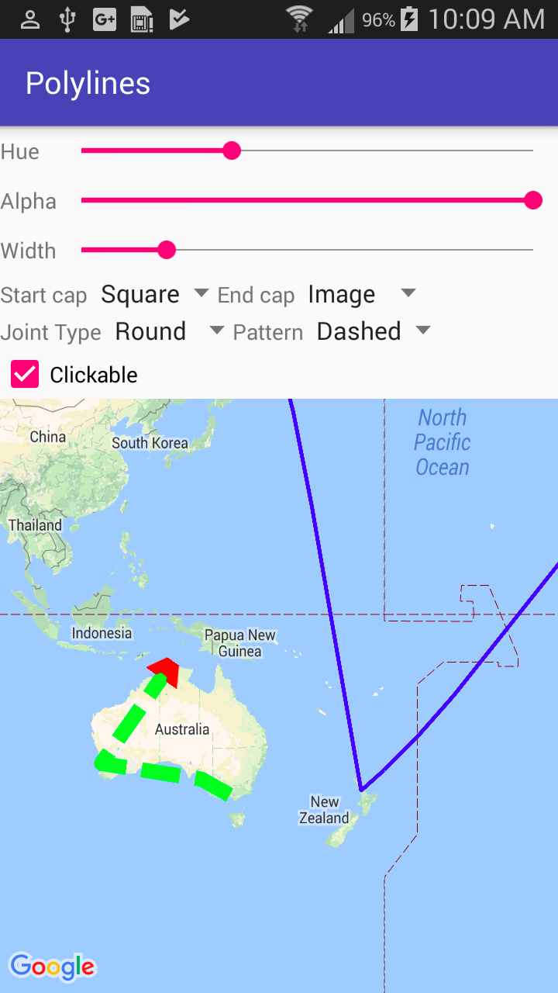
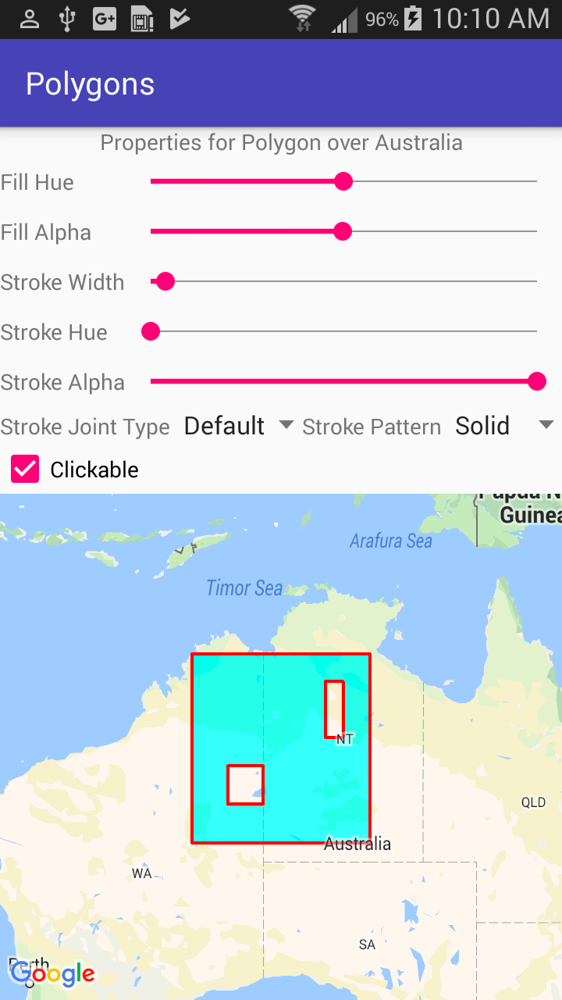
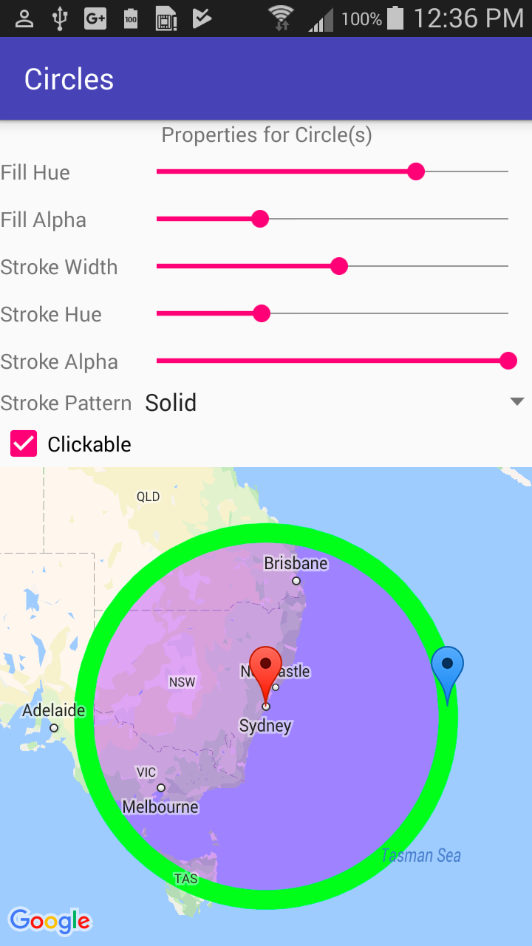
Draw shapes over map
Polylines
Polygons
Circle

Slide 75
Draw shapes over map
Polyline: Series of connected line segments for paths and routes
Polygon: Enclosed shape to mark map areas
Circle: Geographically accurate projection of a circle on Earth's surface
Properties: See Shapes

Slide 76
Street view

Slide 77
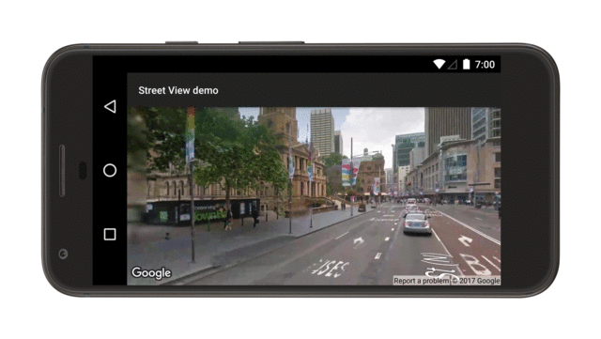
Google Street View

Slide 78
Google Street View
StreetViewPanorama models 360-degree panorama
StreetViewPanoramaFragment for fragment
StreetViewPanoramaView for view
Configure the panorama
StreetViewPanoramaFragment
.newInstance(StreetViewPanoramaOptions options)
StreetViewPanoramaView(Context, StreetViewPanoramaOptions)

Slide 79
What's next?
Concept chapter: 9.1 Google Maps API
Practical: 9.1 Add a Google Map to your app

Slide 80
END

